Slide 1
Cornerstone City Church Peninsula Plus Community Hoo Are Ya
12th May 2024

Slide 2


Slide 3
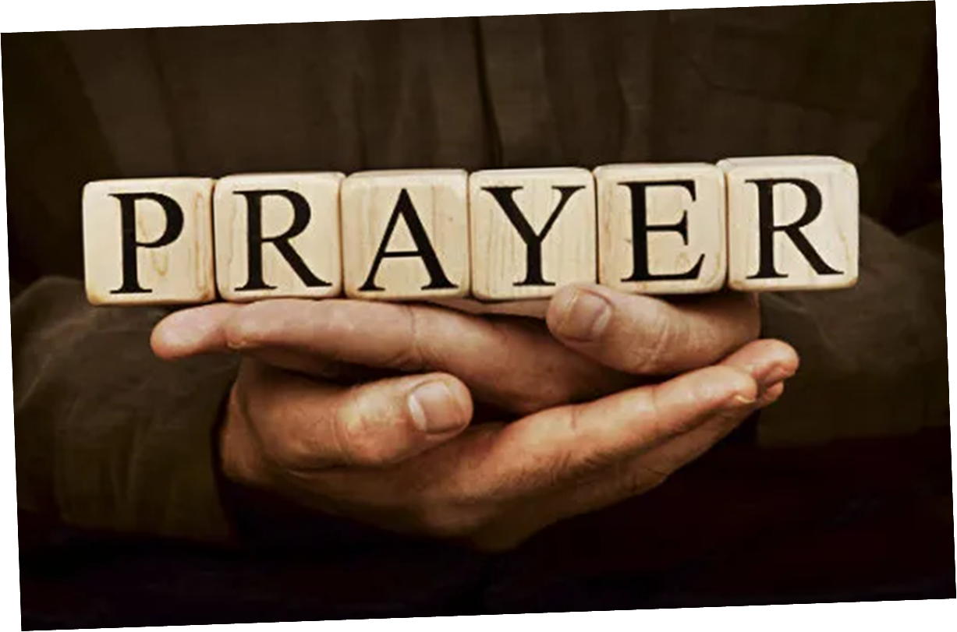

Slide 4


Slide 5
Every Praise
CCLI Song # 6623483
Hezekiah Walker | John David Bratton
© 2013 Davo Pavo Music (Admin. by BMG Rights Management GmbH)
Li'l Eva Music (Admin. by Capitol CMG Publishing)
Luv Ki Publishing (Admin. by Capitol CMG Publishing)
For use solely with the SongSelect® Terms of Use. All rights reserved. www.ccli.com
CCLI Licence No. 33265

Slide 6
1/2
Every praise is to our God
Every word of worship with one accord
Every praise every praise is to our God
Sing hallelujah to our God
Glory hallelujah is due our God
Every praise every praise is to our God

Slide 7
2/2
God my Saviour
God my Healer
God my Deliverer
Yes He is yes He is
(Yes He is yes He is)

Slide 8
My Redeemer Lives
CCLI Song # 2397964
Reuben Morgan
© 1998 Hillsong Music Publishing Australia (Admin. by Hillsong Music Publishing UK)
For use solely with the SongSelect® Terms of Use. All rights reserved. www.ccli.com
CCLI Licence No. 33265

Slide 9
1/4
I know He rescued my soul His blood has covered my sin I believe I believe My shame He's taken away My pain is healed in His name I believe I believe
I'll raise a banner 'Cause my Lord has conquered the grave

Slide 10
2/4
My Redeemer lives
My Redeemer lives
My Redeemer lives
My Redeemer lives

Slide 11
3/4
You lift my burdens
I'll rise with You
I'm dancing on this mountain top
To see Your kingdom come

Slide 12
4/4
My Redeemer lives
My Redeemer lives
My Redeemer lives
My Redeemer lives

Slide 13
10,000 Reasons
CCLI Song # 6016351
Jonas Myrin | Matt Redman
© 2011 Thankyou Music (Admin. by Integrity Music Ltd)
Atlas Mountain Songs (Admin. by SHOUT! Music Publishing UK)
For use solely with the SongSelect® Terms of Use. All rights reserved. www.ccli.com
CCLI Licence No. 33265

Slide 14
1/7
Bless the Lord O my soul O my soul
Worship His holy name
Sing like never before O my soul
I'll worship Your holy name

Slide 15
2/7
The sun comes up it's a new day dawning
It's time to sing Your song again
Whatever may pass and whatever lies before me
Let me be singing when the evening comes

Slide 16
3/7
Bless the Lord O my soul O my soul
Worship His holy name
Sing like never before O my soul
I'll worship Your holy name

Slide 17
4/7
You're rich in love and You're slow to anger
Your name is great and Your heart is kind
For all Your goodness I will keep on singing
Ten thousand reasons for my heart to find

Slide 18
5/7
Bless the Lord O my soul O my soul
Worship His holy name
Sing like never before O my soul
I'll worship Your holy name

Slide 19
6/7
And on that day when my strength is failing
The end draws near and my time has come
Still my soul will sing Your praise unending
Ten thousand years and then forevermore

Slide 20
7/7
Bless the Lord O my soul O my soul
Worship His holy name
Sing like never before O my soul
I'll worship Your holy name

Slide 21
What A Beautiful Name
CCLI Song # 7068424
Ben Fielding | Brooke Ligertwood
© 2016 Hillsong Music Publishing Australia (Admin. by Hillsong Music Publishing UK)
For use solely with the SongSelect® Terms of Use. All rights reserved. www.ccli.com
CCLI Licence No. 33265

Slide 22
1/7
You were the Word at the beginning One with God the Lord Most High Your hidden glory in creation Now revealed in You our Christ

Slide 23
2/7
What a beautiful Name it is What a beautiful Name it is The Name of Jesus Christ my King What a beautiful Name it is Nothing compares to this What a beautiful Name it is The Name of Jesus

Slide 24
3/7
You didn't want heaven without us So Jesus You brought heaven down My sin was great Your love was greater What could separate us now

Slide 25
4/7
What a wonderful Name it is What a wonderful Name it is The Name of Jesus Christ my King What a wonderful Name it is Nothing compares to this What a wonderful Name it is The Name of Jesus What a wonderful Name it is The Name of Jesus

Slide 26
5/7
Death could not hold You The veil tore before You You silence the boast of sin and grave The heavens are roaring The praise of Your glory For You are raised to life again

Slide 27
6/7
You have no rival You have no equal Now and forever God You reign Yours is the kingdom Yours is the glory Yours is the Name above all names

Slide 28
7/7
What a powerful Name it is What a powerful Name it is The Name of Jesus Christ my King What a powerful Name it is Nothing can stand against What a powerful Name it is The Name of Jesus

Slide 30
How Great Is Our God
CCLI Song # 4348399
Chris Tomlin | Ed Cash | Jesse Reeves
© 2004 sixsteps Music (Admin. by Integrity Music Ltd)
Vamos Publishing (Admin. by Integrity Music Ltd)
worshiptogether.com songs (Admin. by Integrity Music Ltd)
Wondrously Made Songs (Admin. by Song Solutions www.songsolutions.org)
For use solely with the SongSelect® Terms of Use. All rights reserved. www.ccli.com
CCLI Licence No. 33265

Slide 31
1/5
The splendour of the King
Clothed in majesty
Let all the earth rejoice
All the earth rejoice
He wraps Himself in light
And darkness tries to hide
And trembles at His voice
And trembles at His voice

Slide 32
2/5
How great is our God
Sing with me
How great is our God
And all will see how great
How great is our God

Slide 33
3/5
And age to age He stands
And time is in His hands
Beginning and the End
Beginning and the End
The Godhead three in one
Father Spirit Son
The Lion and the Lamb
The Lion and the Lamb

Slide 34
4/5
How great is our God
Sing with me
How great is our God
And all will see how great
How great is our God

Slide 35
5/5
Name above all names
Worthy of all praise
My heart will sing
How great is our God

Slide 37


Slide 38
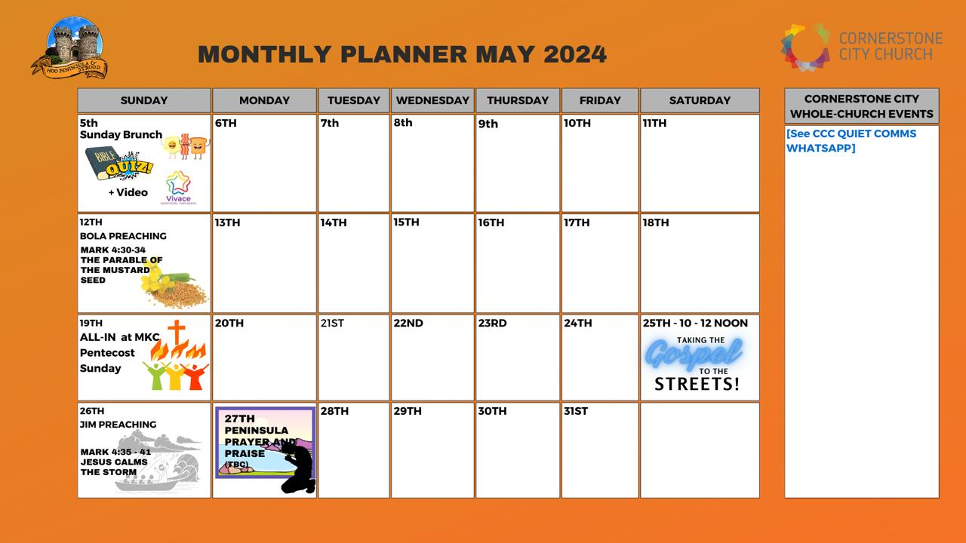

Slide 39


Slide 40


Slide 43
2 Corinthians 14 May the grace of the Lord Jesus Christ, and the love of God, and the fellowship of the Holy Spirit be with you all

